Slide 1

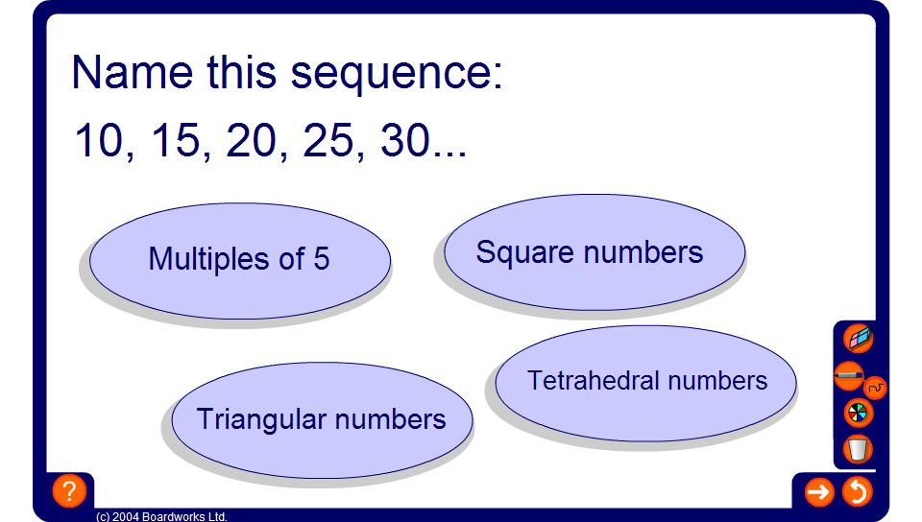


Name that sequence!
Notes:
Use this activity to revise the names of some known (and perhaps unknown!) sequences.

